Slide 1

DR. AMBEDKAR INSTITUTE OF TECHNOLOGY
(An Autonomous Institution, Affiliated to VTU, Belgaum and
Aided by Government of Karnataka)
Near Jnana Bharathi Campus, Bangalore-560056
Department of Information Science & Engineering
MINI PROJECT SYNOPSIS
ON
“R.I.K(Retailer Insights using KNN classification)”
BACHELOR OF ENGINEERING
IN
INFORMATION SCIENCE AND ENGINEERING
2023-2024
SUBMITTED BY
ADITYA G [USN: 1DA21IS004]
YASH SANJAY KAROGAL [USN: 1DA21IS059]

Slide 2


R.I.K Retailer’s Insight using KNN classification
PRESENTATION

Slide 3
Content
01
04
INTRODUCTION
POSSIBILITIES
02
05
OBJECTIVE
CONCLUSION
03
PRODUCT REVIEW

Slide 4

01
INTRODUCTION

Slide 5
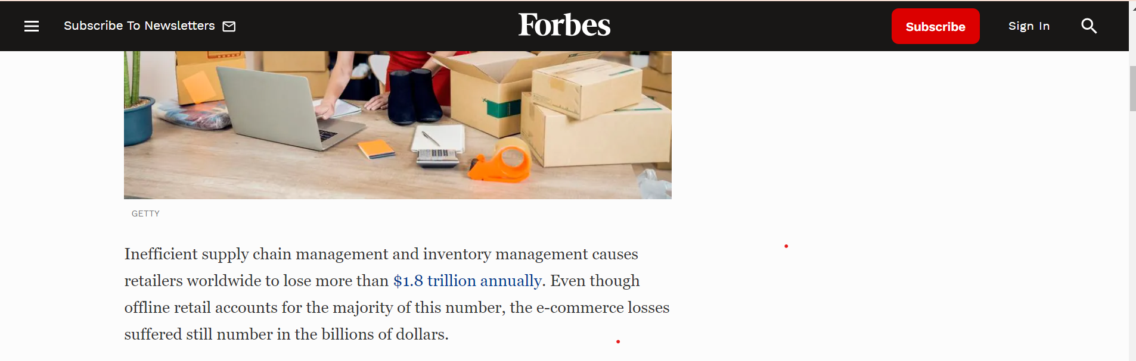
01
INTRODUCTION
Poor and inefficient inventory management of inventory

Slide 6
02
OBJECTIVE

Slide 7



02
OBJECTIVE
Accurate Anticipation
Segmentation Understanding
Operation Efficiency
Restocking and inventory management
Understanding the category and needs of the customer
To increase the efficiency at the retail outlets in increase the sales

Slide 8
03
WORKING AND PRODUCT REVIEW

Slide 9
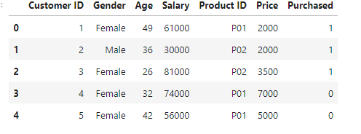
03
Product Review
We loaded the dataset from a well-known repository of customer purchases

Slide 10
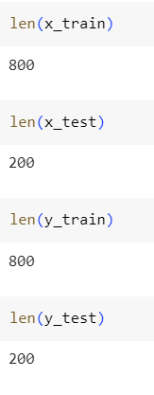
03
Product Review
In the train and test split we are taking 80- 20 split for improving accuracy

Slide 11
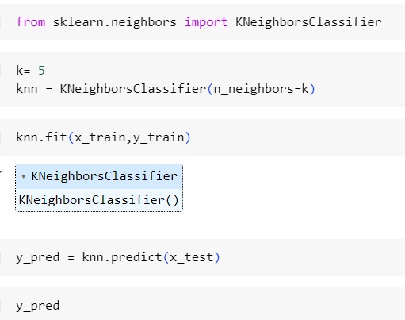
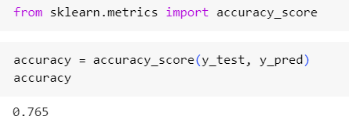
03
Product Review
Using KNN algorithm to train the model
Accuracy of 76.5%

Slide 12
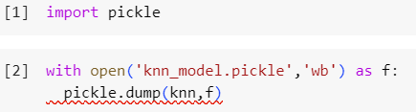


03
Product Review
Storing the trained model using pickle so we can use it in any environment which is compatible with can run python

Slide 13
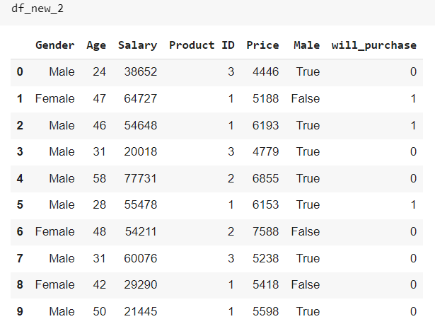
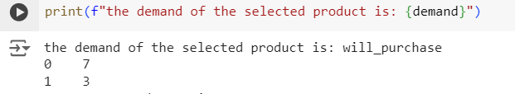
03
Product Review
Now we will understand the demand of the product
7 people will not buy and 3 people will buy

Slide 14
04
POSSIBILITIES

Slide 15
04
POSSIBILITIES
Reduction in Overstock Costs: Predictive analytics can cut excess inventory by up to 30%.
Decrease in Stock outs: Accurate demand forecasting reduces stock outs by 20-50%.
Transportation Cost Savings: Optimized logistics reduce transportation costs by 10-15%.
Warehouse Efficiency: Predictive models improve warehouse efficiency by Enhanced Loyalty
Programs: More effective loyalty programs raise customer lifetime value by 10-20%.
Resource Allocation: Optimized staffing reduces labor costs by 5-10%.
Reduced Returns: Predicting and mitigating returns lowers return rates by 10-20%.

Slide 16
04
POSSIBILITIES
Case Studies
Amazon:
Amazon uses predictive analytics extensively for inventory management and personalized recommendations, contributing to a 35% increase in sales attributed to its recommendation engine alone .
Walmart:
By using predictive analytics for supply chain optimization and dynamic pricing, Walmart reported a 10-20% reduction in logistics costs and a significant increase in overall efficiency .
Procter & Gamble:
P&G implemented predictive models to streamline its supply chain, resulting in a 15% reduction in inventory costs and a 20% increase in forecast accuracy .

Slide 17
05
CONCLUSION

Slide 18
05
CONCLUSION
By leveraging customer predictive models, the retail and logistics sectors can significantly enhance their decision-making processes, leading to improved operational efficiency, better customer experiences, and increased profitability. The ability to anticipate customer needs and behavior allows businesses to stay ahead of the competition and adapt quickly to changing market conditions.

Slide 19

THANK YOU!

